Slide 1
Introduction To Algorithms
ICS 2105

Slide 2
Important Correction
There is no unique set of values for n_{o} and c in proving the asymptotic bounds but for whatever value of n_{o} you take, it should satisfy for all n > n_{o.}( Note again, satisfy for all n > n_{o.})
Example : To prove f(n) = O(g(n)
Suppose we get values c = 100 and n_{o} = 5. This means the asymptotic bound is valid for c = 100 and all n > 5. For the same question, we could also have had c = 105 and n_{o} = 1 which means, the asymptotic bound is valid for c = 100 and all n > 1. Please note, that all the values of n equal to and as well as greater than n_{o} that should be satisfied.
The mistake made during the discussion session was that we just kept in mind the equality that n = n_{o} = 5 and didn’t mention anything about the greater than sign. ( Sorry about that !)

Slide 3
Algorithm Analysis: Example
Alg.: MIN (a[1], …, a[n])
  m ← a[1];
  for i ← 2 to n
  if a[i] < m
  then m ← a[i];
Running time:
  the number of primitive operations (steps) executed before termination
  T(n) =1 [first step] + (n) [for loop] + (n-1) [if condition] +
  (n-1) [the assignment in then] = 3n - 1
Order (rate) of growth:
  The leading term of the formula
  Expresses the asymptotic behavior of the algorithm

Slide 4
Typical Running Time Functions
1 (constant running time):
  Instructions are executed once or a few times
logN (logarithmic)
  A big problem is solved by cutting the original problem in smaller sizes, by a constant fraction at each step
N (linear)
  A small amount of processing is done on each input element
N logN
  A problem is solved by dividing it into smaller problems, solving them independently and combining the solution

Slide 5
Typical Running Time Functions
N² (quadratic)
  Typical for algorithms that process all pairs of data items (double nested loops)
N³ (cubic)
  Processing of triples of data (triple nested loops)
N^{K} (polynomial)
2^{N} (exponential)
  Few exponential algorithms are appropriate for practical use

Slide 6
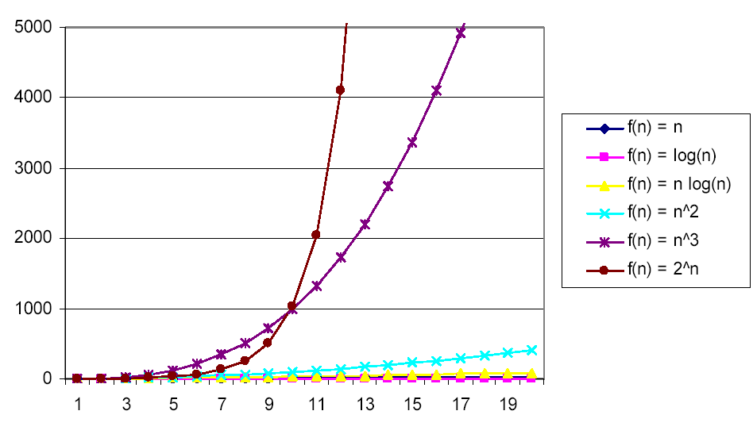
Why Faster Algorithms?

Slide 7
Asymptotic Notations
A way to describe behavior of functions in the limit
  Abstracts away low-order terms and constant factors
  How we indicate running times of algorithms
  Describe the running time of an algorithm as n grows to ∝
O notation:
Ω notation:
Θ notation:
asymptotic “less than”: f(n) “≤” g(n)
asymptotic “greater than”: f(n) “≥” g(n)
asymptotic “equality”: f(n) “=” g(n)

Slide 8
Examples
  2n² = O(n³):
  n² = O(n²):
  1000n²+1000n = O(n²):
  n = O(n²):
2n² ≤ cn³ ⇒ 2 ≤ cn ⇒ c = 1 and n₀= 2
n² ≤ cn² ⇒ c ≥ 1 ⇒ c = 1 and n₀= 1
1000n²+1000n ≤ cn² ≤ cn²+ 1000n ⇒ c=1001 and n₀ = 1
n ≤ cn² ⇒ cn ≥ 1 ⇒ c = 1 and n₀= 1

Slide 9
Examples
  100n + 5 ≠ Ω(n²)
To find c, n₀ such that: 0 ≤ cn² ≤ 100n + 5
100n + 5 ≤ 100n + 5n (for n ≥ 1) = 105n
cn² ≤ 105n
⇒ n(cn – 105) ≤ 0
Since n is positive ⇒ cn – 105 ≤ 0
⇒ n ≤ 105/c
⇒ contradiction: n cannot be smaller than a constant

Slide 10
Examples
  100n + 5 ≠ Ω(n²)
For the above question, we had a solution proposed as follows to prove 100n + 5 = Ω(n²) :-
cn² < 100n + 5
Let n_{o} = 100 . That gives us,
c x 10000 < 100 x 100 + 5
c < 10005 / 10000
So the contant c = 1.0005
But does this work when c = 1.0005 and n = 200 ( remember, it should satisfy for all n > n_{o} . Here n is 200 and n_{o} is 100)
No, it doesn’t work. Hence you cannot prove that
100n + 5 = Ω(n²)

Slide 11
Examples
Prove that 100n + 5 = O(n²)
  100n + 5 ≤ 100n + n = 101n ≤ 101n²
  for all n ≥ 5
  n₀ = 5 and c = 101 is a solution
  100n + 5 ≤ 100n + 5n = 105n ≤ 105n²
  for all n ≥ 1
  n₀ = 1 and c = 105 is also a solution
  Must find SOME constants c and n₀ that satisfy the asymptotic notation relation

Slide 12
Mathematical Induction
Used to prove a sequence of statements (S(1), S(2), … S(n)) indexed by positive integers
Proof:
  Basis step: prove that the statement is true for n = 1
  Inductive step: assume that S(n) is true and prove that S(n+1) is true for all n ≥ 1
The key to proving mathematical induction is to find case n “within” case n+1

Slide 13
Example
For example on how to solve using Mathematical Induction, Refer to Text Book, Appendix A, A.2 .
Also revise Summation formulas and properties from Appendix A.

Slide 14
Recurrences
Def.: Recurrence = an equation or inequality that describes a function in terms of its value on smaller inputs, and one or more base cases
E.g.: T(n) = T(n-1) + n
Useful for analyzing recurrent algorithms
Methods for solving recurrences
  Substitution method
  Recursion tree method
  Master method
  Iteration method

Slide 15
Iteration Method – Example
T(n) = n + 2T(n/2)
T(n) = n + 2T(n/2)
= n + 2(n/2 + 2T(n/4))
= n + n + 4T(n/4)
= n + n + 4(n/4 + 2T(n/8))
= n + n + n + 8T(n/8)
… = in + 2^{i}T(n/2^{i})
= kn + 2^{k}T(1)
= nlgn + nT(1) = Θ(nlgn)
Assume: n = 2^{k}
n = 2^{k}
Taking lg on both sides
lg n = lg (2^{k} )
lg n = klg2
lg n = k x 1
lg n = k

Slide 16
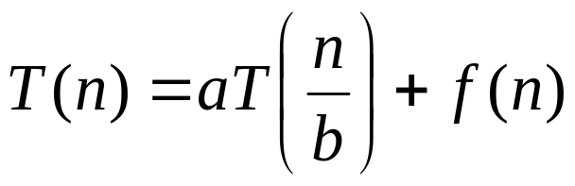
Master’s method
“Cookbook” for solving recurrences of the form:
where, a ≥ 1, b > 1, and f(n) > 0
Case 1: if f(n) = O(n^{log}_{b}^{a -ε}) for some ε > 0, then: T(n) = Θ(n^{log}_{b}ª)
Case 2: if f(n) = Θ(n^{log}_{b}ª), then: T(n) = Θ(n^{log}_{b}ª lgn)
Case 3: if f(n) = Ω(n^{log}_{b}^{a +ε}) for some ε > 0, and if
af(n/b) ≤ cf(n) for some c < 1 and all sufficiently large n, then:
T(n) = Θ(f(n))

Slide 17
Examples
T(n) = 2T(n/2) + n
a = 2, b = 2, log₂2 = 1
Compare n^{log}₂² with f(n) = n
⇒ f(n) = Θ(n) ⇒ Case 2
⇒ T(n) = Θ(nlgn)

